Slide 1
CHC6173
Software Engineering
Lecture 4
Software Modelling
Hong Zhu
School of Engineering, Computing and Mathematics
Oxford Brookes University
Oxford OX33 1HX, UK
Email: hzhu@brookes.ac.uk

Slide 2
Learning Outcomes
1: Principles of Software Modeling
Basics of software modelling
Model-driven software development
2: Software Modelling in UML
Functional Modelling
  Use Cases and Scenarios
  Activity Diagram
Structural Modelling
  Class diagram
Behavioural modelling
  Sequence diagram
  Behaviour state machine

Slide 3
Software Modelling
What is a model
  A model is a set of statements that describes a system at a high level of abstraction
What is a software model
  A model of software system and its environment
What is a modelling language
  A language in which a model is presented
    to build, describe, and analyse software models
    to support the development, operation, maintenance and evolution of software systems

Slide 4
Software Modelling Languages
In Jackson structural programming methodology (JSP)
  Entity lifecycle diagram
In structured software development methodology
  Control flow diagram
  Entity relationship diagram (also used for modelling Relational Databases)
  State transition diagram
In Object-oriented methodology
  UML
In formal methods
  State chart
  Petri nets

Slide 5
Aspects of Modelling Languages
Syntax: defines what is a valid model
  Abstract syntax:
    What are the valid elements to be included in a model
    How are the elements to be connected to each other
  Graphic notation: (concrete syntax)
    How to represent the elements and the connections in the model visually (i.e. the graphic notations)
Semantics: defines the meanings of a valid model
  What do the elements in a model stand for?
  What do the connections between the elements stand for?
Pragmatics: guides the uses of the models
  Heuristic rules on how to use the models to solve certain modelling problems

Slide 6
Model-Driven SW Development
SW models as the key artefacts in software development and evolution
  Models can be easier to understand
  Models can be less ambiguous
  Models can be easier for computer to process
Construction of models as the main objectives in requirements elicitation and specification
  Requirements are defined by a set of models
  Consistency and completeness of requirements definition are checked by analysis of models with support of modelling tool
Design, implementation, testing etc. are considered as transformation and processing of models
  Model transformation are supported by automated tools
  Models can be made executable (e.g. as prototypes)
Supports communication

Slide 7
Holistic Approach to Modelling
Modelling SW on all aspects
  Both the problem and the solution
  Both internal and external views
  Both static structure and dynamic behaviour views
  Both individual and collective views
  Both the system itself and its context/environment
  Both the system-as-is and the system-to-be
  At various levels of abstraction and details
Modelling SW in whole lifecycle
  Requirements engineering
  Design
  Implementation
  Integration and Testing
  Maintenance and evolution

Slide 8
Multiple-Views Approach to Modelling
A complicated systems is best modelled by using a number of different models.
Each model represents one particular point of view to the system and focus on one particular aspect of the system.
These models can be on different levels of abstraction and provide different levels of details.
Consistency problem in multiple-view modelling:
Models of different views and at different levels of abstraction must be consistent so that consistent understanding of the system can be maintained.

Slide 9
Types of SW Models (as in UML)
External view
Internal view
Static view
Dynamic view
Functional model
Use case diagram
Activity diagram
Structural model
Class Diagram
Object Diagram
Component diagram
Package diagram
Behavioural model
Sequence diagram
Communication diagram
Behavioural state machine
Interaction view
Logic view
Individual view
Design & implementation view

Slide 10
Use Case and Scenarios Analysis
The Purposes
To identify all intended uses of the system-to-be
To identify all situations/scenarios of interactions between the system and the users/environment in each use of the system-to-be
To fully understand the interaction sequences, conditions and the information exchanged, etc.
To specify the interactions in a structured way so that models can be constructed from the description.
Notes:
Include relationships factor use cases into additional ones. Includes are especially helpful when the same use case can be factored out of two different use cases. Both Make Appointment and Request Medication include Check Patient Record as a subtask. In the diagram, include notation is a dotted line beginning at base use case ending with an arrows pointing to the include use case. The dotted line is labeled
<<include>>.
An extend relationship indicates that one use case is a variation of another. Extend notation is a dotted line, labeled <<extend>>, and with an arrow toward the base case. The extension point, which determines when the extended case is appropriate, is written inside the base case

Slide 11
What Is A Use Case
A use case is a particular type of uses of the system.
It invokes a set of functions provided by the system in an event flow.
A use case has the
following characteristics:
  A specific set of users of
  the system
  A specific purpose of
  using the system
  A specific context of
  the usage
Use cases are “the typical interactions between the users of a system and the system itself, providing a narrative of how a system is used.” (Martine Fowler, 2004)
“the specification of a sequence of actions, including variants, that a system (or other entities) can perform, interacting with actors of the system.” (UML 2.0, 2003)
It may have different sequences of actions

Slide 12
Description of a Use Case
Unique name of the use case
  The identifier of the use case
Narrative description
  Describes the use case in a short sentence
Participating actors
  Lists the stakeholders/actors involved in use case
Entry conditions
  Defines the state of the system and the actors before the use starts
Exit conditions
  Gives the state of the system and the actor when the use finishes
Flow of events
  Describes the interactions between the actors and the system:
    A normal flow of events
    Exceptional flows (or subflows) of events
Special requirements
  Lists the non-functional requirements associated to the use case

Slide 13
Use Case Description: Example
Purchase an Underground Ticket
Name:
  Purchase ticket
  Description:
  A passenger uses the ATM machine to buy an underground ticket
  Participating actor:
  Passenger
Entry condition:
  The machine has N>0 ticket;
  The passenger has M>0 amount of money
Exit condition:
  The machine has N-1 ticket;
  The passenger has the ticket;
  The machine holds the money m of the ticket’s price;
  The passenger’s money is M-m;
Event flow:
1. The passenger selects the number of zones to be traveled
2. The machine displays the amount m due
3. The passenger inserts money of the amount m’ >=m
4. The machine returns change m’-m
5. The machine issues ticket
Exceptional flows:
4.1 The machine displays a message that it has no changes.
5.1 The machine displays a message that ticket is jam.
Special requirements:
Ticket must be delivered within 5 seconds

Slide 14
What Is A Scenario
An example of events taken from real world experience
  An outline with details of scenes or an imagined sequence of future events, which may include details of the system context (scenes)
  Captured and represented as speech or text narratives and may be embellished with still or moving images to illustrate the context
A future vision of a designed system with sequences of behaviour and possibly contextual description
  A scenario comes close to a design mock up.
  Represented by anything from storyboard sketch to animated sequences in a concept demonstrator.
A single thread (or pathway) through a system
  Formatted text and illustrated pathway in a use case
  A path in an activity diagram

Slide 15
Types of Scenarios
Concrete scenarios
  A sequence of events with every details of data
  A specific operation of the system
Generic scenarios
  A sequence of events without detailed data
  Representation of a set of particular instances of similar operations of the system
As-is scenarios:
  Used in describing a current situation, or system-as-is.
Visionary scenarios:
  Used to describe a future system, i.e. the system-to-be.
Evaluation scenarios:
  Used to check the system in evaluation as acceptance criteria.

Slide 16
Concrete Scenarios
A sequence of events with every details of data
A specific operation of the system
Example:
Online shopping
Go to Amazone.com Website
Browse Computer Books catalogue
Choose UML Distilled (3rd edt.)
Specify quantity of 2
Give delivery address of Dept of Computing, OBU
Give credit card number 1234 5678 9012 3456, and name H Zhu,
Submit order
Concrete actions
Concrete
data

Slide 17
Generic Scenarios
A sequence of events without detailed data
Representation of a set of particular instances of similar operations of the system
Example:
Online shopping
Go to Website
Browse catalogue
Choose product
Specify quantity
Give delivery address
Give credit card detail
Submit order
Concrete actions
No
specific
data

Slide 18
Format of Scenario Descriptions
System/Application: Clinic Management Information System
Use Case: Make appointment at a clinic
Scenario: Successfully booked an appointment
Actor: Patient | System
1) Enters their own name and their preferred doctor’s name | 2) After confirming this is a registered patient, displays days the doctor is in the clinic
3) Selects date | 4) Displays available appointment
5) Selects preferred time | 6) Confirms appointment and displays information about parking etc
7) Confirms acceptance of appointment

Slide 19
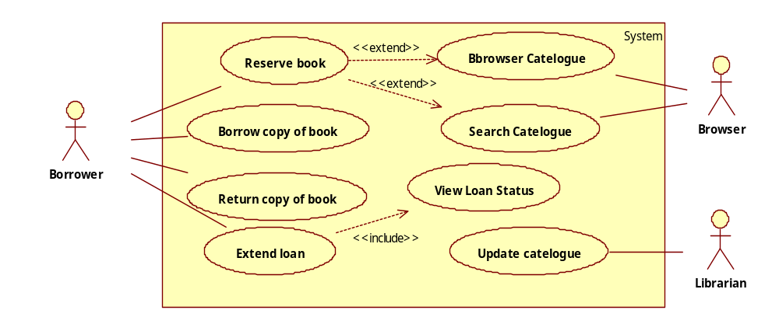
UML Use Case Models
Contains actors, use cases and relationships between them
Describes the functional operations (or the requirements) of a software system through use cases

Slide 20
UML Use Case Diagram Notation
Actors represent roles, that is, a type of user of the system and the environment
Use cases represent a sequence of interactions for a type of usage
Uses relations represent that the actor uses the system in this use case, i.e. there are the interactions between the actors and the system in the use case
Include and Extend Relationships between use cases represent how use cases are interrelated with each other
Scope box defines the scope of the system by indicating that a subset of use cases (included in the box) are to be implemented
actorName
useCase Name
<<extend>>
<<include>>

Slide 21
UML Activity Diagrams
actionName
Action node: an action
Control flow
objectName
Object node: represent an object
Object flow
Initial node: beginning of a sequence of activities
Final node: stop all control flows and object flows
Stop node: terminates a specific control flow or object flow
Swim lane: break up an activity diagram into parts to assign the activities to the actors
Decision node
Merge node
Synchronisation
Fork
Join

Slide 22
Concepts of Activity Diagrams
Action
  Performed for some specific business reason
  Can be manual or computerised
  Named by a verb with a noun, e.g.
    Make payment arrangement
    Book an air ticket
    Enter delivery address
Special actions
  Initial, Final, Stop, Fork, Merge, Synchronisation

Slide 23
Control Flow and Object Flow
Control flow
  Model the path of execution through a business process
  Can only be attached to action/activity nodes
Object flow
  Model flow of object through a business process
  Show the objects that flow into and out of the actions or activities (i.e. passed between activities)
  Similar to dataflow in dataflow diagrams
  Attached to one action/activity node and an object node

Slide 24
Example: Make an Appointment
Decision node
Object node
Get patient info
Decision condition
[old patient]
[New patient]
Appt request form
Create new patient record
Appt request form
Make an appointment
Object flow
Appt

Slide 25
Swim Lane
Breaking up an activity diagram into parts by placing actions into the swim lane boxes
Assigning responsibility to objects or individuals that performs the actions by assign a name of object/individual to each swim lane
Representing parallel and concurrency of executions
Modelling a business workflow,
  Describing ‘who is doing what’ using swim lanes
  Describing ‘how they coordinate’ using synchronisation bars

Slide 26
Example: Make a School Lunch Box
Father
Mother
Get jelly
Get bread
Get drink
Get dessert
Get peanut butter
Create sandwich
Get lunch box
Put lunch in box

Slide 27
Principles of OO Methodology (1)
An information system should be structured in such a way that it reflects the structure of the real world system
  Easier to understand the information system
    Metaphor: using the same vocabulary to describe the entities in the information system as the users describes the things, ideas and concepts in the real world
  Easier to modify the information system
    Users’ requirements tend to change much more frequently than the structure of their organisation and the domain
    Changes in organisation system can be relatively easily reflected in the modification of the information system

Slide 28
Principles of OO Methodology (2)
‘Everything in the world is object’
  The real world can be modelled by objects
  Everything in an information system should be an object in order to satisfy principle 1
  All information systems can be modelled in OO approach
Real world
Semantic gap
World of software
Analysis phase
Design phase
Model of the real world
Model of the SW world

Slide 29
Object-Orientation
Object
  A set of attributes:
    The states of real world objects are reflected by the values of the attributes
  A set of methods:
    The changes of states are reflected in the collection of methods that changes the states of objects
  The set of attributes and the set of methods are encapsulated into one computational entity
Encapsulation:
  It means as much as shielding. Each OO object has a shield around it. They can exchange things though, as if they are interconnected through a hatch.
  Only the operations are visible and the data and the implementation of the operations are hidden in the objects

Slide 30
Class is called the classifier of objects, similar to data type is the classifier of data
Class
  The similarity between objects is reflected by classifying them into the same class.
  Objects are instances of classes
  Class is the template for a collection of objects that have the same structure, i.e.
    the same set of attributes, and
    the same set of methods.
In mainstream OO methodology, objects does not change their membership to the classes.
Class is an abstract thing that does not actually exist in the system at runtime.

Slide 31
Relationships between Classes
Generalisation
  Definition:
  Class A is a generalisation of class B, if every instance of class A is also an instance of class B.
    Class A is called a super-class of B; class B is called a subclass of A.
    We also say that class B is a specialisation of A.
    A relationship between classes: the super-class /subclass relationship is also called inheritance relation.
        Class B inherits the attributes and methods of A.
  Example:
    Undergraduate Student is a subclass of Student;
    Postgraduate Student is a subclass of Student;
    Student is a subclass of Person;
    Lecturer is also a subclass of Person

Slide 32
Whole-part relationships
  Whole-part: Object A is a part of object B
    A wheel is a part of a car
  Aggregation: an object consists of several other objects
    A car consists of 4 wheels, 1 engine, 1 steering wheel, …
  Key features of whole-part relationship
    Life-dependence:
      Whether a part object can exist without being a part of a whole object
    Shareability:
      Whether a part object can be a part of more than 1 object
    Cardinality: (also called multiplicity):
      How many part objects can be contained in 1 whole object
  Types of whole-part relations in UML:
    Aggregate: shareable, but no life-dependence
    Composite: life-dependent and not shareable
E.g. Heart is a part of human body.
E.g. Your money is also mine.

Slide 33
Read, think then answer
Check if the whole-part relationships between these classes are aggregate or composite?
Class 1 | Class 2 | Type of whole-part relationship
Body | Leg
House | Room
Car | Engine
Person | Doctor
Composite
Composite
Aggregation
Generalization
This is not a whole-part relationship

Slide 34
Association
  An object A affects another object B’s state, e.g. object A can directly cause object B to change its state (by invocation of object B’s method).
    A doctor operates on a patient
    Engine drives wheels
    Steer wheel change the direction of wheels
  An object A monitors another object B’s state, e.g. object A accesses B’s attributes.

Slide 35
UML Class Diagram
Class name
Attributes
Methods
Class name
Aggregate
Class node without compartments
Composite
Class node with 3 compartments
Inheritance
Association

Slide 36
Example: Inheritance Relation
Vehicle
Buffalo cart
Truck
Aircraft
Jumbo-jet
Helicopter

Slide 37
Examples: Multiplicity
Car
Car
Car
1
0..1
4
4..5
Wheel
Wheel
Wheel
A wheel is a part of car
A car has 4 wheels.
A wheel can be on 1 car at any time.
A car may have 4 or 5 wheels.
A wheel may be fixed on 1 car, but it may also be not used by any car.

Slide 38
Example: Hospital
Person
Symptom
Illness
0..*
0..*
Schedules
Treatment
Employee
Patient
1
0..*
Appointment
1..*
0..*
1
Nurse
Doctor
Leads to
Has scheduled
0..*
0..*
1..*
Bill
Administrative staff
0..1
*
Health Team

Slide 39
Attributes and Methods
Attributes (also called properties)
  Representation of object’s state
  Similar to variables in the sense that they can store values
Methods: ( also called operations)
  Operations that can change the values of the attributes
  Similar to procedures/functions
Visibility: the level of information hiding to be enforced for the attribute/method
  Public (+): not hidden from any object; other objects can modify its value;
  Private (-): hidden from all other objects;
  Protected (#): hidden from all other classes except its immediate subclasses.
Notes:
Software Engineering stopped here

Slide 40
Example: Attributes & Methods
Person
#surname
#first name
#address
#telephone
#date of birth
#/age
Patient
-amount
…
+make appointment
…
Derived attribute:
Its value is calculated from other attributes rather than stored.

Slide 41
Behavioural Models
Behavioural models describe the internal dynamic aspects of an information system that supports the business processes in an organisation
At requirements analysis stage
  Internal logic of the business processes
  Without specifying how the system is implemented
At design and implementation stage
  Details of the designs of the system, such as
    the data types of the attributes
    the operations of the objects
Behaviour model describes the ‘journey between the towns’, i.e. the interactions between the objects to achieve the functions of use cases.

Slide 42
Two Types of Behaviour Models
Interaction models
  Describe the collaboration between objects and actors in the business process by describing how objects and actors in the system communicate, cooperate and coordinates with each other
  In UML, they are described by sequence diagrams and communication diagrams
Individual models
  Describe the behaviour of individual objects and actors by describing how they change their states and the actions to be taken in each state and the outside condition.
  In UML, they are described by state machines associated to classes

Slide 43
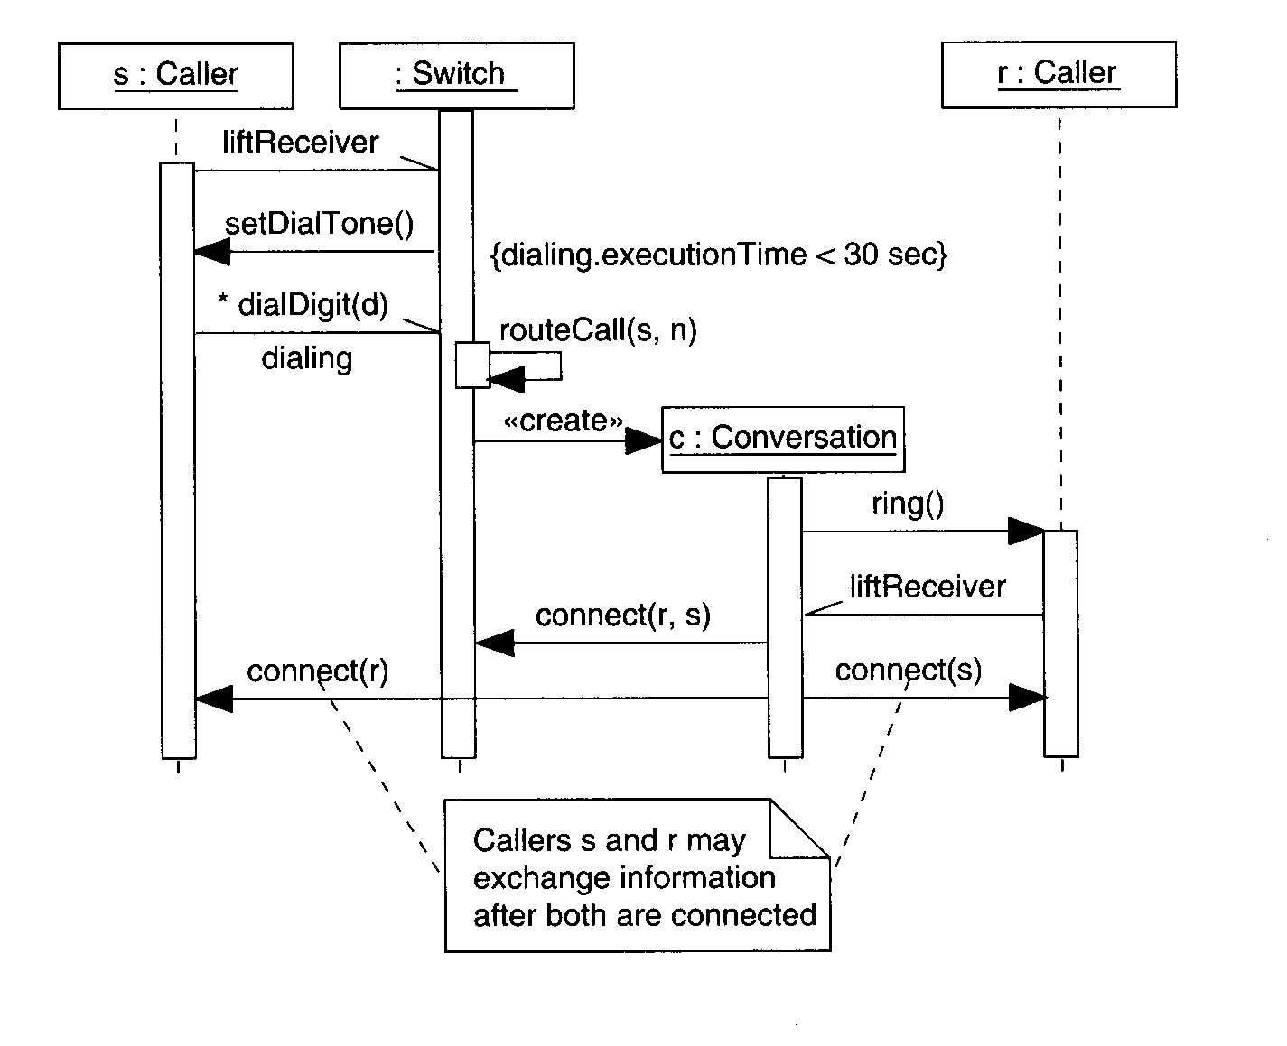
Example: telephone connection
notation using
an object constraint
language
The objects are:
sender (person)
receiver (person)
telecoms switch
conversation
UML notation
for a note

Slide 44
Elements of Sequence Diagrams
<<actor>>
Actor/Role
Actor: A person or system that derives benefit from and is external to the system
anObj: Class
Object: Participants in an interaction depicted in the sequence diagram by sending and/or receiving messages
Lifeline: denotes the life of an object during the interaction depicted in the sequence diagram
aMessage()
Message: conveys information from one object to another one
Return value
Execution occurrence: denotes when an object is sending and/or receiving messages
Object destruction: shows an object is going out of existence

Slide 45
Message flows
There is only ONE thread of execution, and activity passes from one object to another.
Message flow annotation:
Procedural or synchronous - a message is sent by one object to another, and the first object WAITS until the resulting action has completed.
Asynchronous - a message is sent by one object to another but the first object does NOT wait until the resulting action has completed, it carries on with the next step in its own sequence of actions.
Flat - each arrow shows a progression from one step to the next in a sequence. Normally the message is asynchronous, but can be used for both (sync. and async. modes)
Return - represents the explicit return of control from the object to which the message was sent (optional).
More than one object can be active at any one time. This would be the case in a multi-threaded system.
Notes:
CS

Slide 46
Generic vs Instance Sequence Diagrams
For each use case, there may be a collection of sequence diagrams that describes the behaviour of the system.
  One generic sequence diagram
    Shows all possible interactions (i.e. all scenarios) between the objects/actors in a use case
    May contains conditionals, loops, etc.
  A number of instance sequence diagrams.
    Depicts a single scenario (i.e. one linear sequence of message passing) of the interactions between the objects/actors of the use case.
    Does not contain any conditionals, loops, etc.

Slide 47
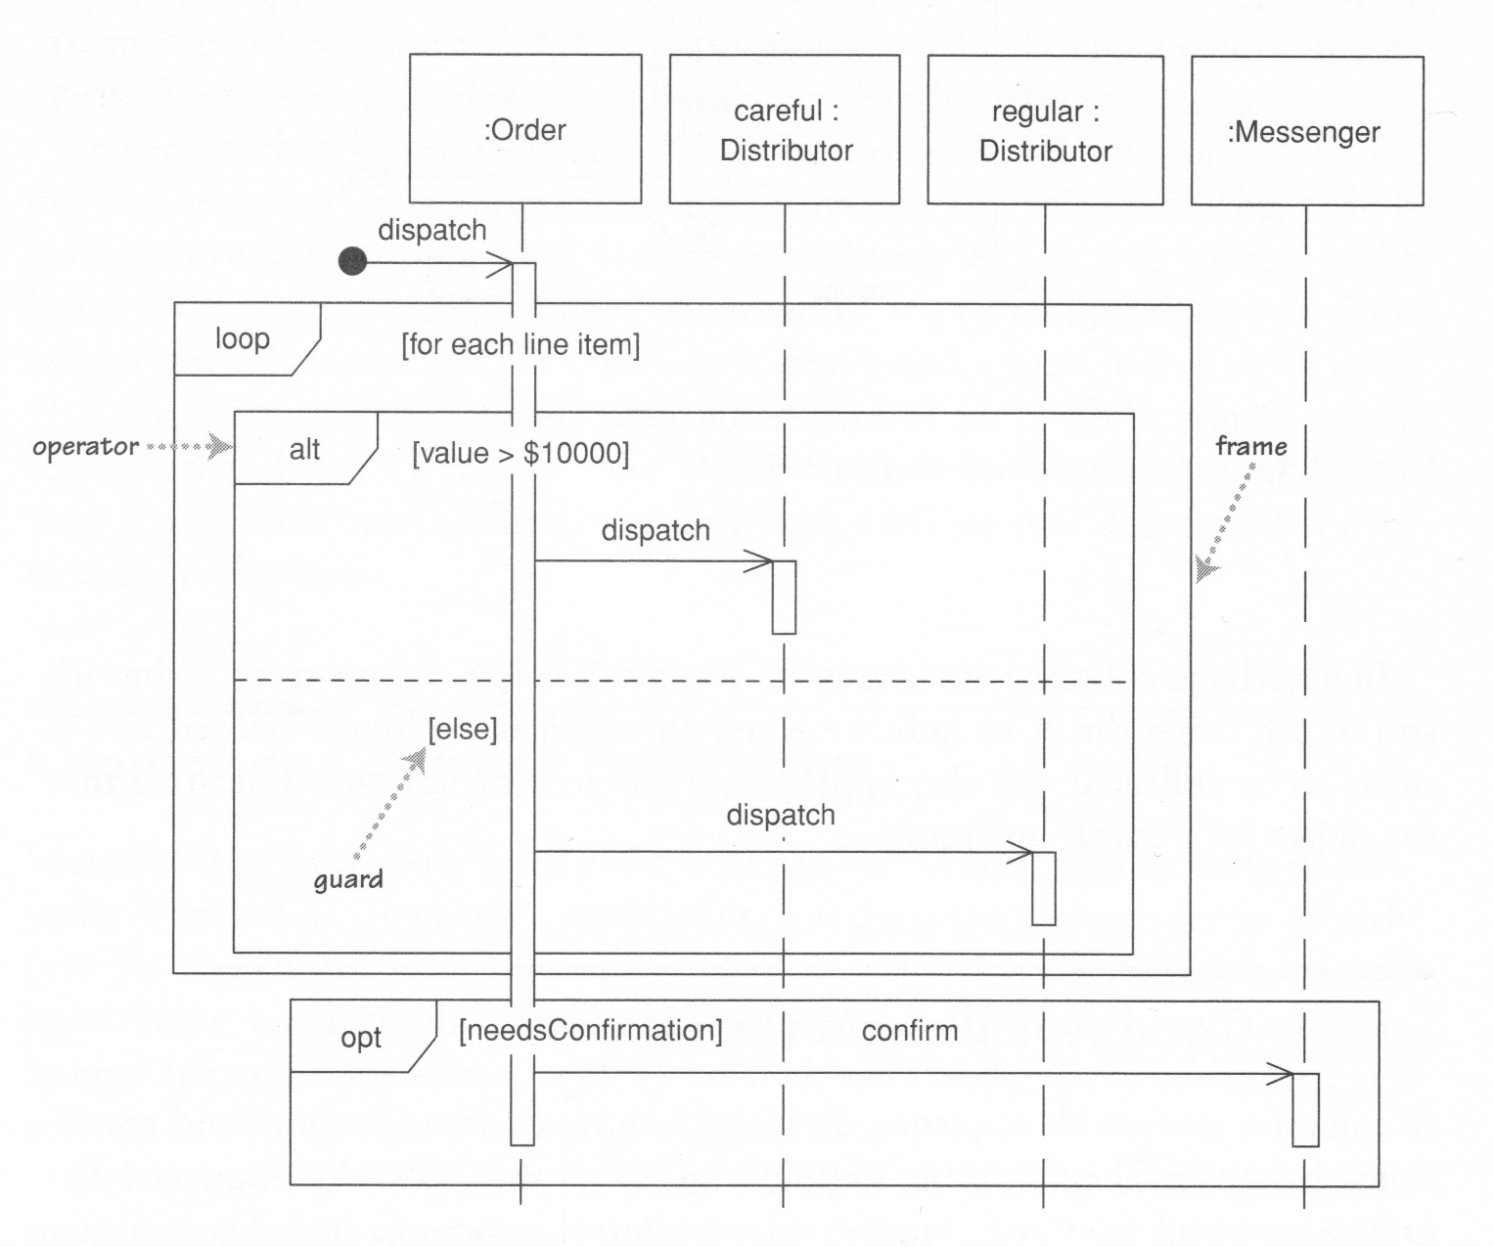
Example of Frames

Slide 48
Common Operators for Interaction Frames
Operator
Meaning
alt
Alternative multiple fragments; only the one whose condition is true will execute.
opt
Optional; the fragment executes only if the supplied condition is true. Equivalent to an alt with only one trace.
par
Parallel; each fragment is run in parallel.
loop
Loop; the fragment may execute multiple times, and the guard indicates the basis of iteration.
region
Critical region; the fragment can have only one thread executing it at once.
neg
Negative; the fragment shows an invalid interaction.
ref
Reference; refers to an interaction defined on another diagram. The frame is drawn to cover the lifelines involved in the interaction. You can define parameters and a return value.
sd
Sequence diagram; used to surround an entire sequence diagram, if you wish.

Slide 49
Behavioural State Machines
A dynamic model that shows
  the different states that a single object passes through during its life
  its response to events with changes on its state and the actions.
Used for further definition of the behaviour of objects
Enters Hospital
> 2 weeks
[Diagnosis = healthy]
Checks in
Released
Waiting
Admitted
[Diagnosis =Unhealthy]
[Diagnosis = healthy]
Under observation

Slide 50
Basic Concepts of State Machines
State:
  The state of an object is defined by the values of its attributes and its relationships with other objects at a particular point in time.
  E.g. a patient can be new, current, or former.
Event:
  Something that takes place at a certain point in time and changes a value of an attribute.
  For example:
    A designated condition becoming true
    The receipt of a call for a method by an object
    Passage of a designated period of time
Transition:
  A relationship that represents the movement of an object from one state to another state.
  A transition is trigger by an event;
  A transition may be associated with an action/activity. The action/activity takes place when the state transition happens
  A transition may have a guard condition, which is a Boolean expression. The transition happens only when the guard condition is true

Slide 51
Notation of State Machines
state
State node
Initial state
Final state
[guard condition] Event/Action
State transition

Slide 52
Internal activities
Event, guard and activities can be put inside the state box to represent reactions to events without transitions.
Example: A state of a text field object on a user interface.
When enters the state
State name
When exits the state
Typing
Entry/ highlight all
Exit/ update field
Character/ process character
Help [verbose]/ open help page
Help [quiet]/ update status bar
When the event happens (in this case when the user types in a character)
Guard condition
(i.e. the activity is taken only if the condition is true)
Internal activities

Slide 53
Activity State
An activity state is a state in which the object is performing an ongoing activity. It transits the state when the activity terminates.
The activity state is represented by the mark “do/ activity” in the state.
Activity state
Updating hardware window
Searching
do/ search for new hardware
search
cancel
Displaying new hardware window

Slide 54
Superstate
A superstate is a state that inside is a state machine.
It can be used to express shared behaviours, and to represent behaviours in a hierarchical manner.
Show Connections
Superstate
new
Substate
cancel
save
Enter Connections Details
next
Choose Shared or Solo
next
Enter Name
Enter Phone Number
back
back

Slide 55
Concurrent States
States can be broken into several orthogonal state diagrams that run concurrently.
On
time
alarm
Concurrent boundary
Display Current Time
Display Alarm Time
Playing radio
Playing CD
H
radio
CD
History pseudostate
on
off
Off

Slide 56
Guide to Study
Further Readings
  Alan Dennis, Barbara Haley Wixom, and David Tegarden, Systems Analysis and Design with UML: An Object-Oriented Approach, 3rd Edition, Wiley, 2010
    Chapter 6, pp207~237
    Chapter 7, pp238-268
  Martin Fowler, UML Distilled (3rd Edition), Addison-Wesley, 2004.
    Chapter 4: Sequence Diagrams, pp53-64,
    Chapter 10: State Machine Diagrams, pp109-116
  Bhuvan Unhelkar, Software Engineering with UML, Taylor & Francis, 2017
  Kevin Lano, Model-Driven Software Development with UML and Java, Cengage Learning Emea, 2009

